Slide 1
Problem Statement
At field locations, the army needs staying in bunkers and tents as their camps are located
in remote parts of the country.
Sporadically, they are deprived of essential facilities such as hospitals and medications.
During such times, it becomes critical for the Medical Corps to ensure that
no soldier is left unattended and proper medication and treatment is provided as and
when required.
This application is built with an aim to assist the Medical Corps of the US Army to
arrange medical facilities and address their needs in exercise/field areas for armed forces
Camps under their jurisdictions.

Slide 2
Approach following
The nurse from every Military Camp will take care of unwell soldiers(patients).
The nurse can admit patients to the Camp Medical room.
The Nurse can also request the following to the Camp Commandant alerted via email too:
Beds 2. Medical Supplies 3.Apply Leave
In case of Emergencies the nurse can directly contact the Doctors at the Medical Camps alerted via SMS:
Extra Medical Staff 2. Beds
The Camp commandant will further send requests to Medical Camp Doctors or food Suppliers:
Relieving Nurse 2. Medical Supplies for the Camp 3. Moving patients to Medical Camp
They are also responsible for requesting Food Supplies from Food Supplier and managing the Camps Food Inventory.
The Camp Commandant can also see the analysis for his Camp referring to a dashboard.
He can also refer to maps to see his location and locations of nearby medical camps.
The Doctor will process all the request forwarded by Camp Commandant and emergency requests forwarded by Nurse.
Apart from that he can manage bookings for resident patients.
He is also responsible for managing the inventory for medical supplies and request the same from medical suppliers.
The food Suppliers addresses the requests from Camp Commandants and supplies items from their own inventory.
The medical Suppliers addresses the requests from Doctors and supplies items from their own inventory.

Slide 3
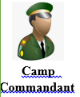
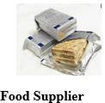

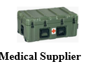

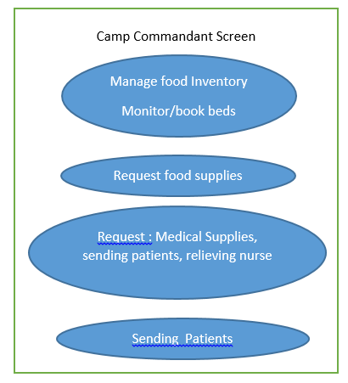
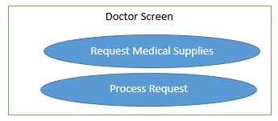
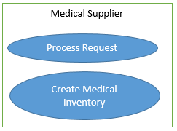
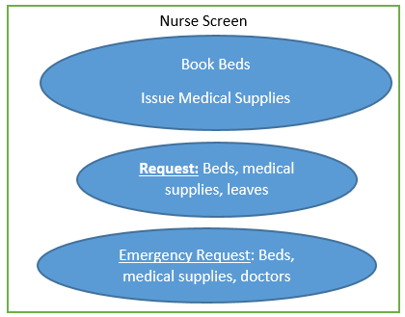
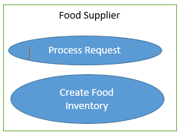
Design/Use Case

Slide 4
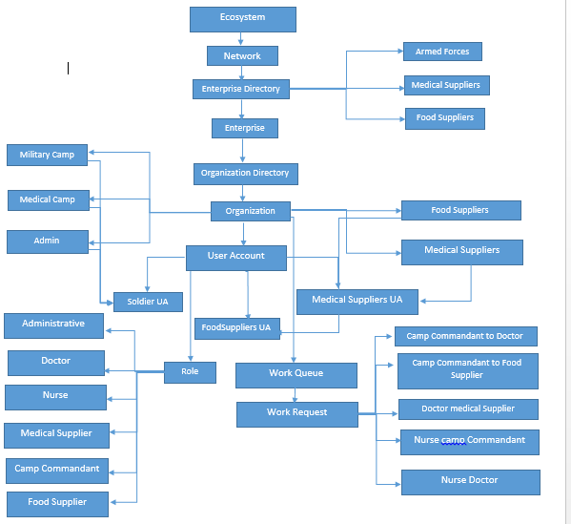
Object Model

Slide 5
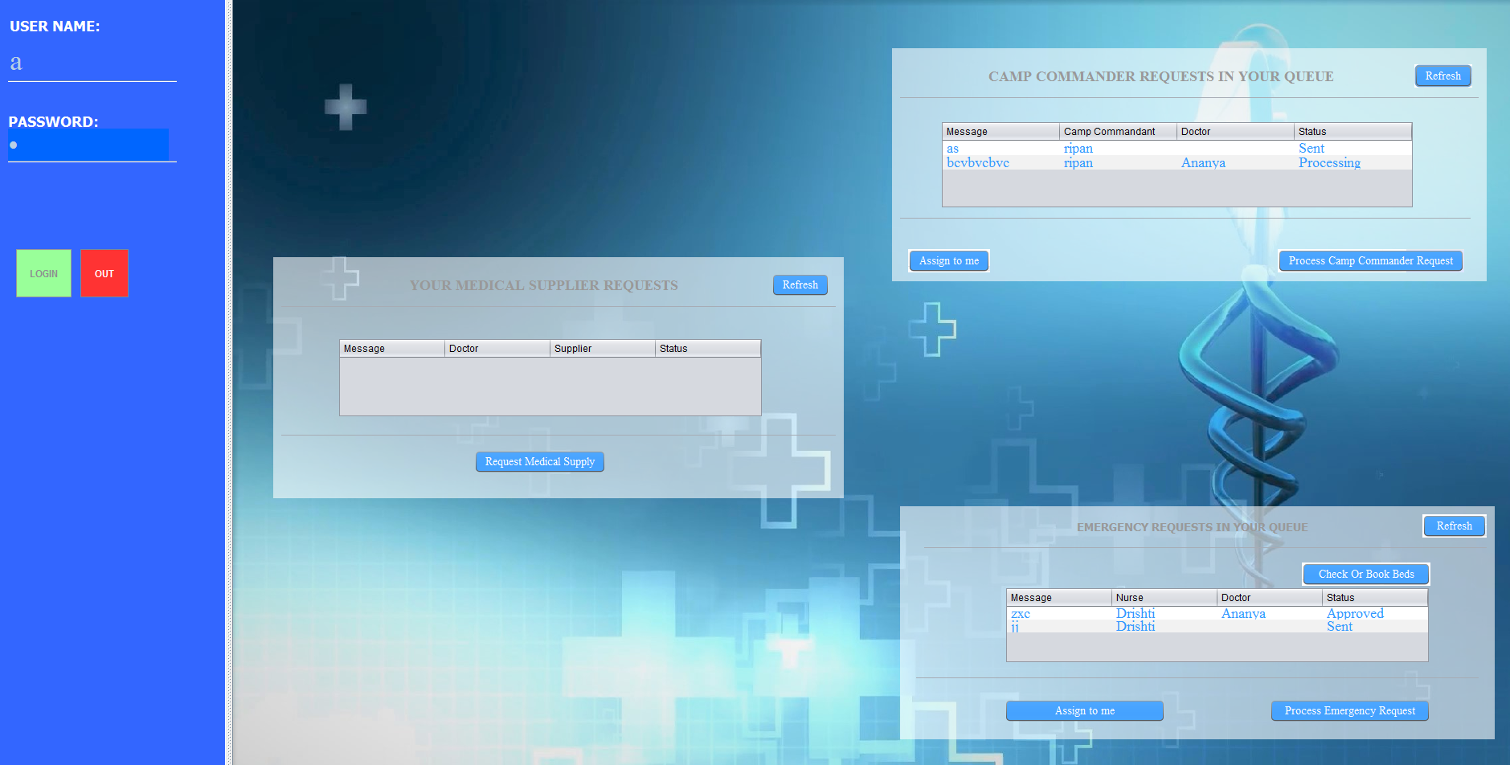
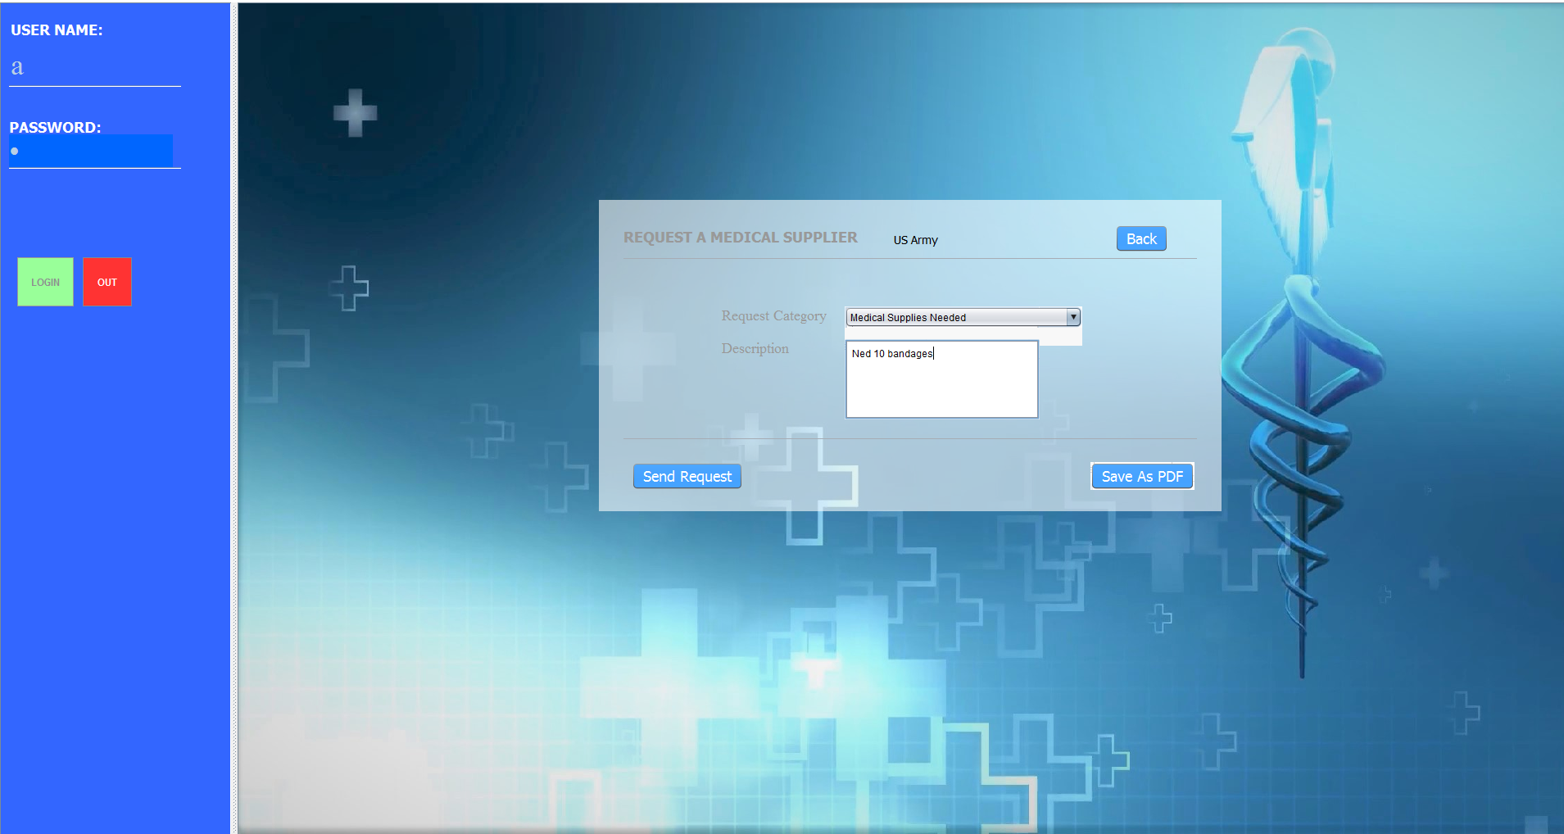
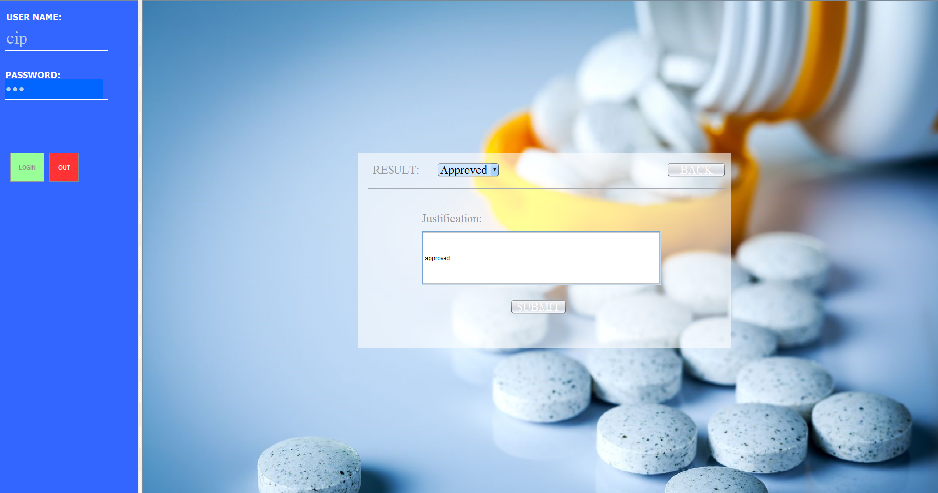
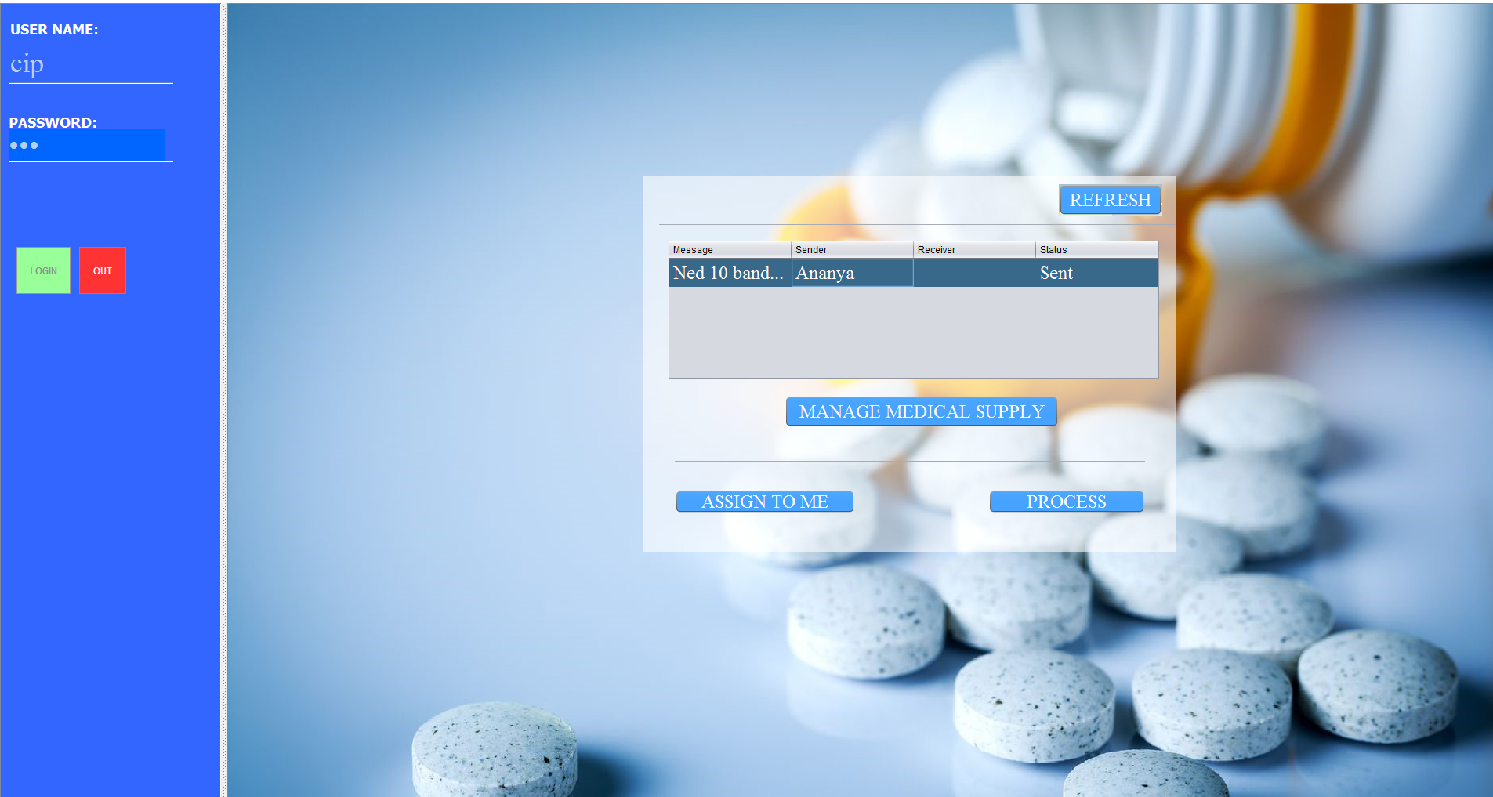
Demo (Screenshots with key use cases)
Doctor Home Screen
Doctor Request Medical Supplies
Medical Supplier Approves the Request
Medical Supplier Logs In

Slide 6
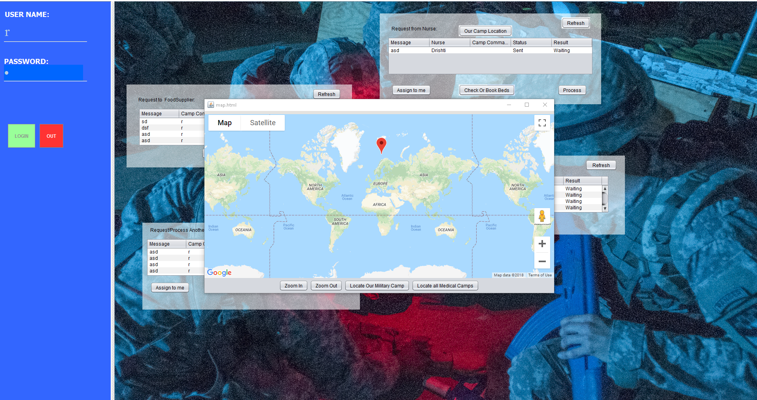
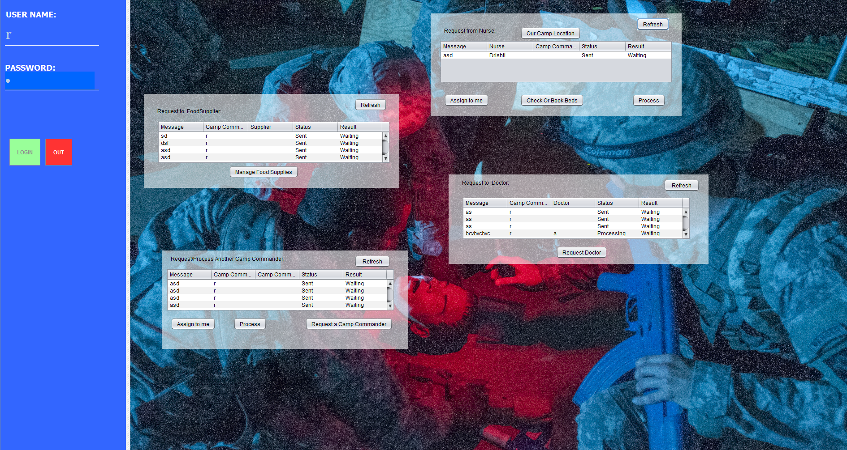
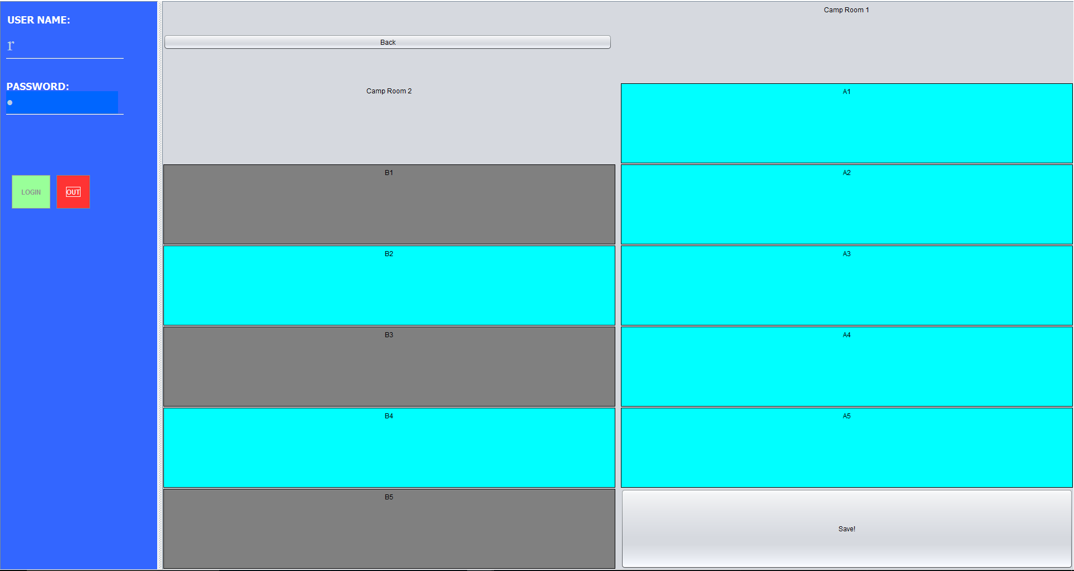
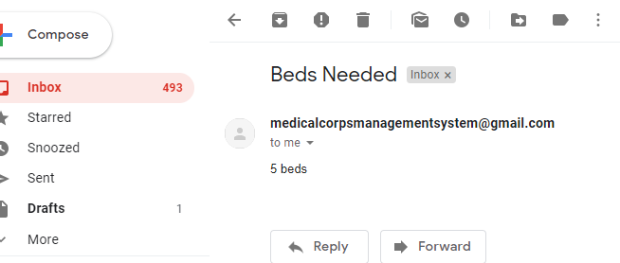
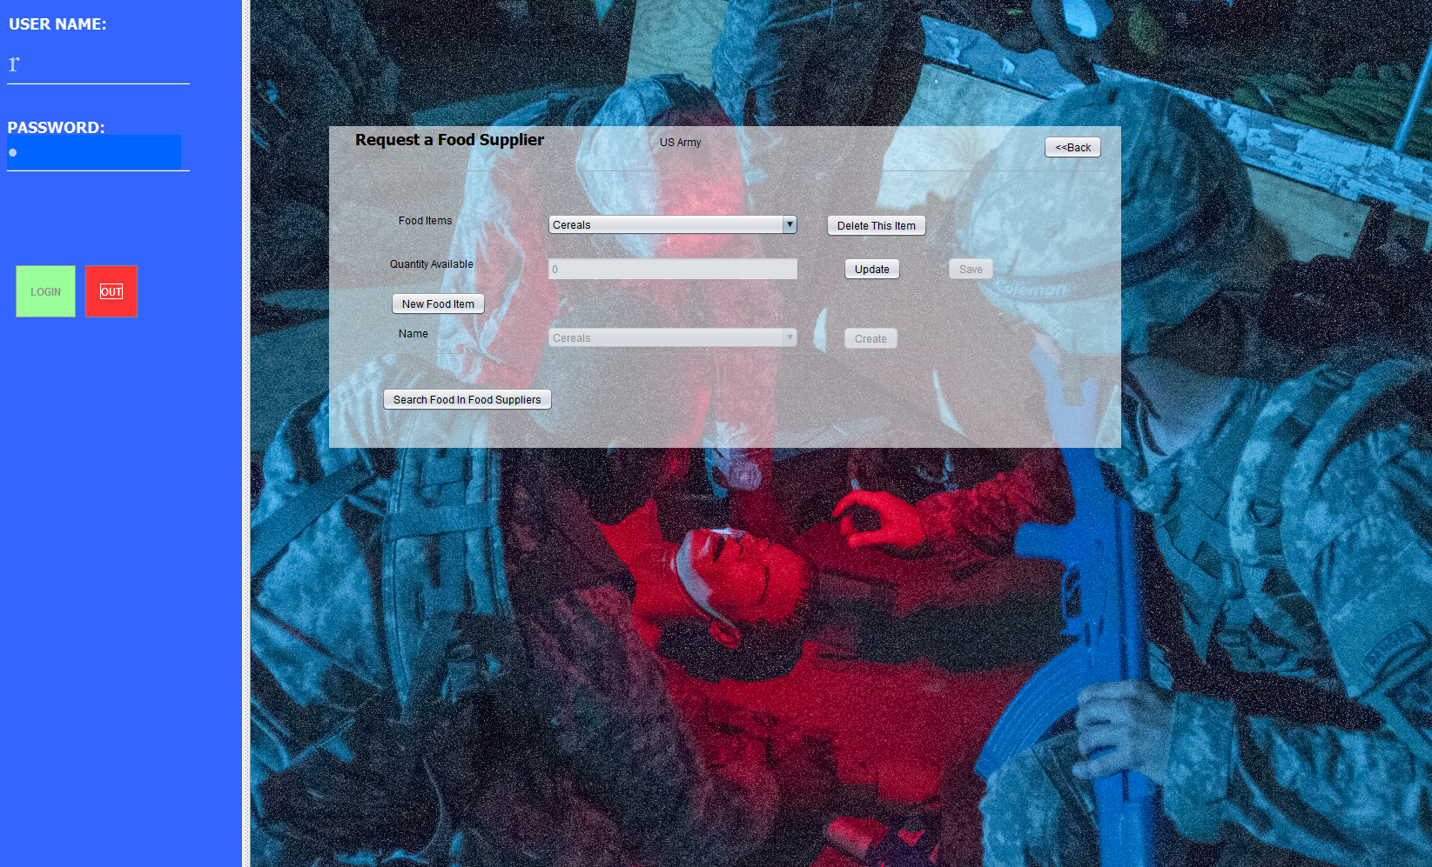
Demo (Screenshots with key use cases)
Camp Commandant Home Screen
Camp Commandant Checks Locations of Nearby Medical Camps
Camp Commandant Sends Email
Camp Commandant Requests Food
Camp Commandant Reserves Bed

